Slide 1
Evaluating Vulnerabilities and Implementing Solutions for MD5 Digital Signatures
CAN304
Notes:
Good afternoon Dr., representing for group 2, we are delivering this presentation based on Vulnerabilities and Implementing Solutions for MD5 Digital Signatures as a report for CAN304 assinment1.

Slide 2


Content：
1. Introduction, Motivation and Background
2. Literature Survey
3. Problem Identification
3.1 High collision rate
3.2 Slow execution speed
3.3 Length extension attack
4. Proposed solution and novelty
4.1 Optional solution
4.2 Novel solution
5. Implementation and Testing
6. Conclusion
Notes:
This presentation will be separated into 6 segments as displayed on this screen.

Slide 3
Introduction, Motivation and Background
Intro:
MD5 digital signature technology
use to verify the authenticity and integrity
BG:
The rapid development of the Internet.
Security concerns become complex.
Unauthorized individuals can intercept and modify the transmitted data.
Motivation:
Create a unique signature to guarantee data authenticity.
Ensure the data hasn’t been tampered and prove a document is indeed signed.
Notes:
This report investigates the use of the MD5 algorithm in digital signature technology, discussing its advantages, disadvantages, and potential security improvements. We present a detailed description of the MD5 algorithm, discuss the process of digital signatures, and identify the problems associated with the MD5 algorithm, such as high collision rate, slow execution speed, and vulnerability to length extension attacks, which lead to its security issues like unauthorized interception and modification of transmitted data. In order to create a unique signature to guarantee data authenticity and ensure the data hasn’t been tampered and prove a document is indeed signed, we propose potential solutions to improve the security of MD5, including salted hashing, key hashing, iterated hashing, and the introduction of an encoding step using a symmetric encryption algorithm such as AES.

Slide 4

Literature survey：
MD5: (encrypt any length data into a 128-bit message digest)
Principle:
based on a hashing algorithm
compress the input data → a 128-bit digital fingerprint
Process:
Features:
Padding
Initialization
Iteration
Output
Fast
01
02
03
04
.
Nonreversible
Fixed-length
Collision rate
.
Notes:
The MD5 encryption algorithm is based on a hashing algorithm, which compresses the input data into a 128-bit (16-byte) digital fingerprint by performing multiple operations on the input data. This digital fingerprint is unique and irreversible, which means the original data cannot be reversed from the digital fingerprint. The main process of the MD5 encryption algorithm consists of four steps: padding, initialization, iteration, and output. It also has the following features: first, fast and suitable for encrypting a large amount of data; second, it outputs a fixed-length digital fingerprint, which is not affected by the length of the original data; third, it cannot be reversed from the digital fingerprint to the original data; fourthly, it has the collision resistance property.

Slide 5
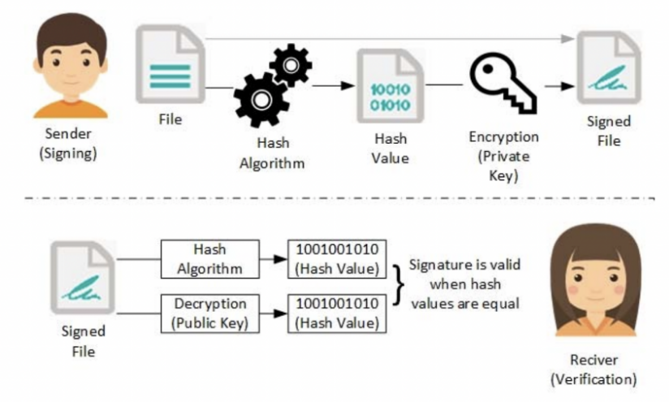
Literature survey：
Digital Signature: (based on public key cryptography and hashing algorithms)
Process:
Sender: encrypt the digest to generate a digital signature.
Sender: send it to the receiver.
Receiver: decrypt it to obtain the hash value.
Receiver: digest the received message and generate a new hash.
Receiver: compares the new hash value with the other hash value.
Notes:
The digital signature is a technique used in digital communication to verify message integrity and authentication, which is achieved by using a combination of public key cryptography and hashing algorithms. The process of digital signature is as follows [6].
The sender digests the message using a hashing algorithm and encrypts the digest using a private key to generate a digital signature.
The sender sends the digital signature and the message to the receiver.
The receiver decrypts the digital signature using the public key to obtain the hash value of the message.
The receiver uses a hashing algorithm to digest the received message and generate a new hash.
The receiver compares the new hash value with the hash value decrypted from the digital signature. If they are the same, the message is intact; otherwise, it has been tampered with.

Slide 6
Literature survey：
Digital Signature: (based on public key cryptography and hashing algorithms)
Features:
Verifying message integrity
Authentication
Protection against repudiation
.

Slide 7
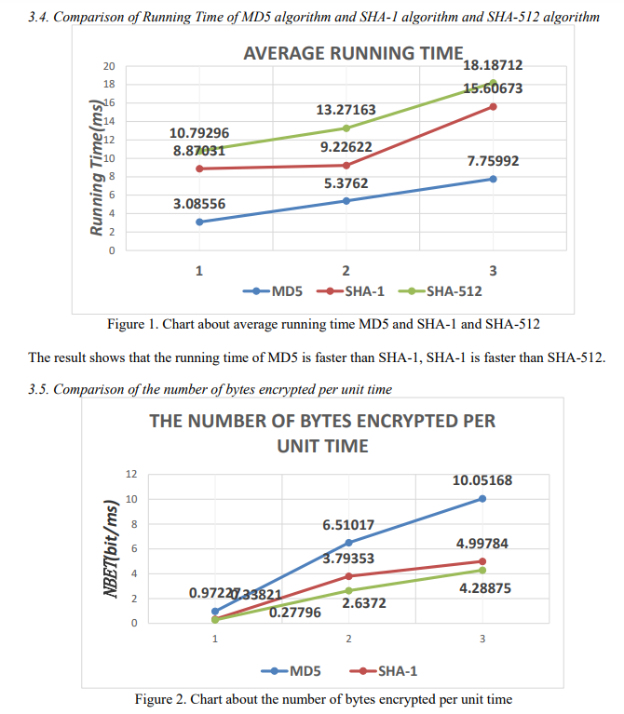
Problem Identification：
High collision rate
The output might be the same hash value when processing two different inputs. Leading to fraud, even the compromise of data integrity.
Slow execution speed
It should be short and requires less buffer.
But it is slower than other hash algorithms, like SHA-256.
Notes:
Despite the wide application in authentication and digital signature, it is considered unreliable in three aspects.
The first one is a high collision rate compared with other hash functions. In certain scenarios, collision attacks occur when the cryptographic hash functions are implemented to process two different inputs, which output the same hash value. This collision can lead to fraud and even compromise of data integrity. Researchers compared the collision rate value between MD5 and SHA-1. The CR value of MD5 is higher than SHA-1 in the latter part, which indicates that MD5 is less secure than SHA-1.
As for any algorithms, the implementation time with a given file should be short and require less buffer. Otherwise, the hash algorithm is comparatively vulnerable and easy to crack. MD5 is relatively slower in execution than other hash algorithms.

Slide 8
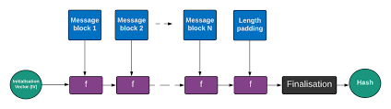
Problem Identification ：
Length Extension Attack
An attacker could reconstruct the internal data by appending new data and adding length padding so that the length is the same as the original message.
Notes:
Length Extension Attack
The basic logic of MD5 is to take the input message and transform it into internal data. An attacker could reconstruct the internal data by appending new data and adding length padding so that the length is the same as the original message, which may allow them to produce a new hash for the fake message.

Slide 9
Proposed solution and novelty：
Optional solution:
Salted Hashing:
Adding a random “salt” value to the input message.
Key Hashing:
Incorporating a secret key into the hash function.
Iterated Hashing:
Hashing the message multiple times, with the output of each iteration becoming the input for the next iteration.
Notes:
Optional solution
One way to improve the security of MD5 is to use a technique called "salted hashing". This involves adding a random "salt" value to the input message before hashing it with MD5. The salt value is then stored alongside the hash value.
Another technique is to use a keyed hashing approach. This involves incorporating a secret key into the hash function, which encrypts the message before hashing it with MD5. The key is then used to decrypt the message when verifying the hash value.
A third technique is to use iterated hashing. This involves hashing the message multiple times, with the output of each iteration becoming the input for the next iteration.
However, these methods do not address the fundamental weaknesses in the algorithm itself.

Slide 10
Proposed solution and novelty：
Novel solution:
Utilizing a symmetric encryption algorithm:
Keep the secret key remain confidential and secure between the sender and receiver.
Adding a random “padding” value:
Complicating the attacker's task of determining the correct input message.
Compare hash value after computing:
The receiver decrypts the encoded hash value using the secret key and subsequently compares the decrypted hash value to the original message's hash value.
Notes:
A possible approach for encoding the MD5 hash output involves utilizing a symmetric encryption algorithm, such as AES, to encrypt the hash value with a secret key. This secret key must remain confidential and be securely exchanged between the sender and receiver. A random "padding" value would be inserted at a random position within the message before hashing, thus complicating the attacker's task of determining the correct input message. During hash value verification, the receiver would first decrypt the encoded hash value using the secret key and subsequently compare the decrypted hash value to the original message's hash value. If the two values match, it signifies that the message has not been tampered with or altered.

Slide 11
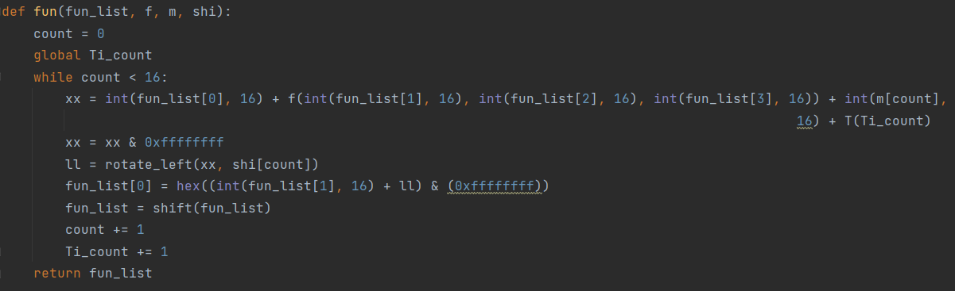
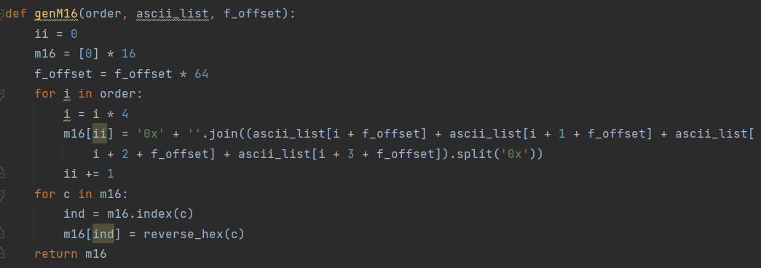
Implementation and Testing：
Use Python to implement the MD5 algorithms.
Core components: input segmentation and FFGGHHII.
MD5 hash generation for input strings
Improved encryption and verification process by substring replacement in MD5 output.
Notes:
Firstly, fill the input with a 1 and multiple 0s and connect it to its length data to make the data obey a certain form that can be divided by 512 bits. We will separate the processed data into 64 bytes per segment. For the first segment, we define 4 standard magic numbers, all of which are 16 bytes. Then we divided the 64-byte data into 16 segments as parameters for the core functions, which refer to FF, GG, HH, and II. They mainly include bit logic, addition, and shift operations to achieve hash functionality. Each of the core functions executes 16 times in sequence and takes turns changing the values of the four magic numbers, with the length of the magic numbers unchanged. After an entire round, the values of the four magic numbers are changed, and the initial values of this round are added. They will then be the magic numbers for the next round. After each segment of data completes the processing, we can get the final value by connecting the four processed magic numbers. This is the complete process of MD5 output. Our encryption is based on obtaining this MD5 result. By cutting out a specific length of data from a certain position in the middle and replacing it with random data, we can obtain the ciphertext with the front and the end retained. And during verification, we calculate the MD5 data of the plaintext and compare the two segments at the same position with the two segments of the ciphertext. If they are completely the same, the verification is considered successful.

Slide 12
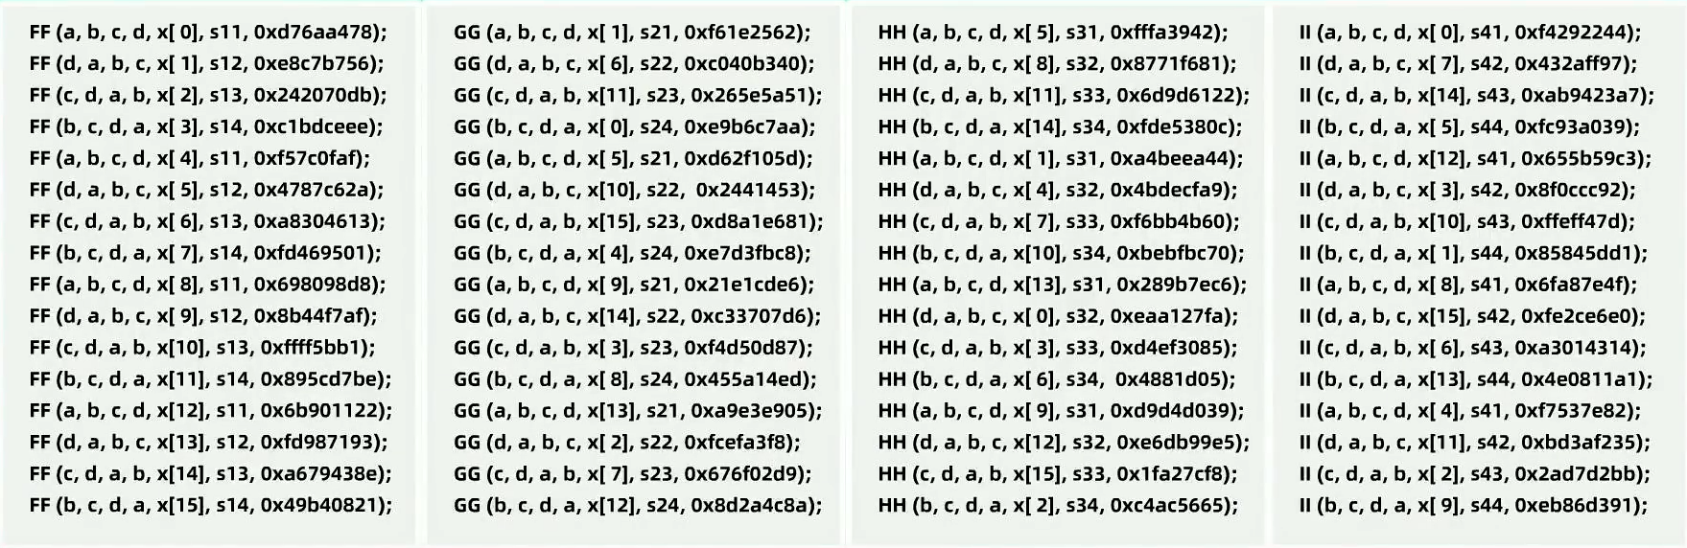
Implementation and Testing：
Parameters:

Slide 13
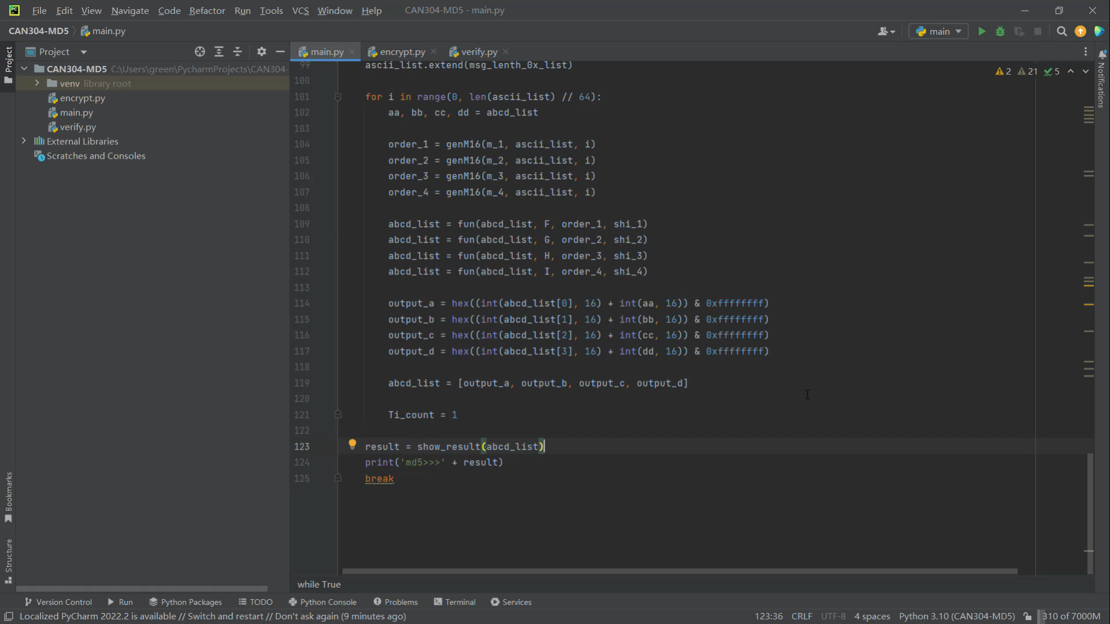
Implementation and Testing：
Demonstrate video:

Slide 14
Conclusion：
MD5 algorithms:
Consistency, Slow and Repetition Rate
Enhancing MD5 security technologies used for digital signature
Limitations of MD5 improvements
(Do not resolve fundamental weaknesses)
Transition to More Secure Hashing Algorithms
(Like SHA-256)
Notes:
In conclusion, while the MD5 algorithm was once widely used in digital signatures, there are some vulnerabilities that limit its reliability. Although we introduce some solutions to improve it, it’s better to use more secure hashing functions for digital signature applications

Slide 15
Thank You
Question?
Notes:
Thank you for listening! This is the end of our presentation. If you have any questions, please feel free to ask us.

